Slide 1

Topic 7:
Instruction Set of 8086
By: Mr. Binu Joy

Slide 2
Why study instruction set?
Study of instruction set is required to write instructions in machine code that can be recognized and executed by a central processing unit.
The knowledge will help you write lines of code or program by which you will be able to tell the processor, the sequence of operations to be performed.

Slide 3
What are we going to study?
Instruction Set
  Different types of instructions with examples
  How to use instructions in assembly language programming

Slide 4
Types of addressing mode in 8086
Data Copy/Transfer instructions
Arithmetic
Logical instructions
Shift & Rotate instructions
Branch instructions
Loop instructions
Machine Control instructions
Flag Manipulation instructions
String instructions
Will be covered later

Slide 5
1: Data Copy/Transfer instructions
MOV Destination, Source
There will be transfer of data from source to destination.
Eg:
MOV AX,BX
Source can be register, memory location or immediate data.
Destination can be register or memory operand.
Both Source and Destination cannot be memory location or segment registers at the same time.
AX
BX
10 AB
FF 33
10 AB
AH AL
BH AL

Slide 6
1: Data Copy/Transfer instructions
PUSH Source
Pushes the 16 bit content specified by source in the instruction on to the stack
Eg:
PUSH BX
Pushing operation decrements stack pointer stack pointer.
Stack pointer is a 16-bit register, contains the address of the data item currently on top of the stack.
SP
5000
5001
5002
5003
50
01
02
00
FF
33
BX
10 AB
10 AB
10
AB
BH AL

Slide 7
1: Data Copy/Transfer instructions
POP Destination
Pops the 16 bit content from stack to destination specified in instruction.
Eg:
POP DS
10
Popping operation increments stack pointer stack pointer.
SP
5000
5001
5002
5003
DS
AB
01
50
00
02
22
33
FF
33

Slide 8
1: Data Copy/Transfer instructions
XCHG Destination, Source
This instruction exchanges contents of Source with destination.
Eg:
XCHG BX,AX
It cannot exchange two memory locations directly.
10 AB
FF 33
BX
AX

Slide 9
1: Data Copy/Transfer instructions
IN AL/AX, 8-bit/16-bit port address
It copies data to accumulator from a port with 8-bit or 16-bit address.
Eg:
IN AL, 80H
Eg:
IN AX, DX
DX is the only register is allowed to carry port address.
80 00
AX
12 34
12
AX
80
AH AL
PORT
AH AL
PORT
80 00
DX

Slide 10

2: Arithmetic Instructions
Addition
Subtraction
Increment
Decrement
Multiply
Divide

Slide 11
2: Arithmetic Instructions
ADD Destination, Source
This instruction adds the contents of source operand with the contents of destination operand. The result is stored in destination operand.
Eg:
ADD AX,BX
The source may be immediate data, memory location or register.
The destination may be memory location or register.
AX is the default destination register.
AX
AX
BX
20 00
12
70 00
50 00
XX XX
+
AH AL
AH AL
BH BL

Slide 12
2: Arithmetic Instructions
ADC Destination, Source
This instruction adds the contents of source operand with the contents of destination operand with carry flag bit.
Eg:
ADD AX,BX
The source may be immediate data, memory location or register.
The destination may be memory location or register.
The result is stored in destination operand.
AX is the default destination register.
AX
AX
BX
CY
20 00
+
12
XX XX
50 00
+
70 01
1
AH AL
AH AL
BH BL

Slide 13
2: Arithmetic Instructions
INC source
This instruction increases the contents of source operand by 1.
Eg:
INC AX
The source may be memory location or register.
The source can not be immediate data.
The result is stored in the same place.
AX
AX
70 01
70 00
+
1
70 00
AH AL
AH AL

Slide 14
2: Arithmetic Instructions
MUL operand
This instruction will multiple unsigned operand 8-bit/16-bit with AL/AX and store the result in AX/DX-AX.
Eg:
MUL BH
Operand may be general purpose register or memory location.
If operand is of 8-bit then multiply it with contents of AL.
If operand is of 16-bit then multiply it with contents of AX.
Result is stored in accumulator AX in 8 bit operation and DX-AX in 16bit operation.
AX
AX
BX
XX XX
XX 04
X
12
00 08
02 XX
AH AL
AH AL
BH BL

Slide 15
2: Arithmetic Instructions
DIV Operand
This instruction will divide unsigned operand AX/DX-AX by 8-bit/16-bit number and store the result in AX/DX-AX
Eg:
DIV BL
Operand may be general purpose register or memory location.
AL=AX/Operand (8-bit)
AL= Quotient, AH=Remainder.
AX=DX-AX/Operand (16-bit)
AX= Quotient, DX=Remainder.
AX
AX
BX
88 88
88 88
04 04
12
/
XX 22
AH AL
AH AL
BH BL

Slide 16
3: Bit Manipulation Instructions (LOGICAL Instructions)
AND
OR
XOR
NOT

Slide 17
3: Bit Manipulation Instructions (LOGICAL Instructions)
AND
Especially used in clearing certain bits (masking)
xxxx xxxx AND 0000 1111 = 0000 xxxx
AX
BX
XX 88
XX 88
XX 08
12
Eg:
AND BL, 0FH
X
XX 0F
AH AL
BH BL

Slide 18
Reflection Spot
You just studied about the AND operator is used to clear certain bits. Which operator would be used to set certain bits without effecting the other bits
Pause and write your answer in your course journal

Slide 19
Reflection Spot (Answer)
OR
Used to multiply each bit in a byte/word with the corresponding bit in another byte/word.
xxxx xxxx OR 0000 1111 = xxxx 1111
AX
AX
20 00
20 00
20 08
12
Eg:
MOV AX, 2000h
OR AX, 0008h
or
00 08
AH AL
AH AL
0010 0000 OR 0000 1000 = 0010 1000
This sets bit 4 in the AX register

Slide 20
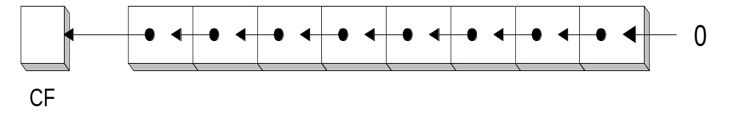
4: Instructions to perform shift operations
SHL
The SHL (shift left) instruction performs a logical left shift on the destination operand, filling the lowest bit with 0.
After
Before
XX 0A
XX 05
Eg:
MOV BL,5d
SHL BL,1
XX 05
BH BL
BH BL
0 | 0 | 0 | 0 | 1 | 0 | 1 | 0
0 | 0 | 0 | 0 | 0 | 1 | 0 | 1

Slide 21
5: Branch instructions
CALL − Used to call a procedure and save their return address to the stack.
  Eg: CALL Label
RET − Used to return from the procedure to the main program.
JMP − Used to jump to the provided address to proceed to the next instruction.
  JMP Label

Slide 22
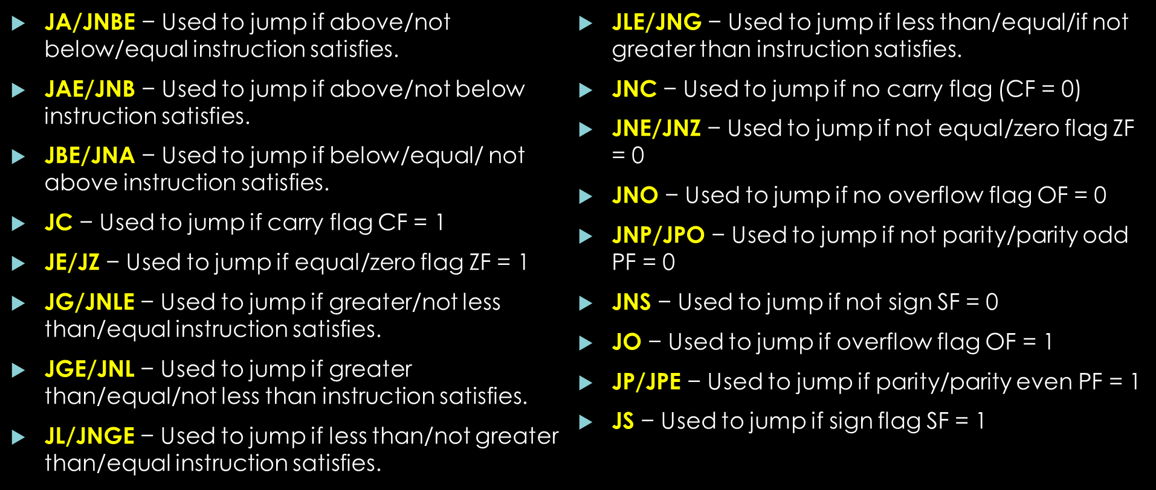
5: Branch instructions
Instructions to transfer the instruction during an execution with some conditions

Slide 23
Summary
What we have learnt
  Studied 5 types of instruction set.
  How different instructions can manipulate data in different ways.

Slide 24
References
Advanced Microprocessors and Peripheral
  - By K Bhurchandi, A. K. Ray

Slide 25
This presentation is licensed to the public Text is available under the Creative Commons Attribution-ShareAlike License

